Slide 1
Making it fair: conquering hidden bias
Annette Gregg, mba
Senior vice president, AlliedPRA
Owner, difference makers consulting

Slide 2
Agenda
Definition and Causes
Dangers
Recognizing Hidden Bias
Solutions
Notes:
Where we will go today..
Many interactive activities to demonstrate how subconscious this trait can be
There will be a lot of heavy data and thoughts, but I promise there is hope. We need it now more than ever
Let’s do our first poll!

Slide 3
A quick poll
Only 15% of American men are over 6'tall. What percentage of male CEOs are over 6' tall?
20%
40%
60%
75%
Notes:
60%

Slide 4
A quick poll
Based on your professional experience, please agree or disagree with this statement: "On the whole men make better business executives than women do."
Agree
Disagree
Notes:
**70% of women and 80% of men agree with this statement!

Slide 5
A quick poll
I have chosen a candidate based on his/her "fit" with my team
Yes
No

Slide 6
A quick poll
I feel I have been discriminated against in my career
Yes
No

Slide 7
Your turn
Form groups of two or three people each
Introduce yourself: name, title, handshake
Then answer the question “If you really knew me, you’d know….”
Notes:
EXERCISE- if you really knew me…..we make judgements based on looks, dress, handshake….how many of you learned something you would not have guessed “fit” with that person?
Use this for teams…social groups etc.

Slide 8
Definition and causes
It’s all about the brain
Notes:
Everyone has it

Slide 9
definition
An implicit stereotype or bias is the unconscious attribution of particular qualities to a member of a certain social group. Implicit stereotypes are influenced by experience, and are based on learned associations between various qualities and social categories, including race or gender.
Notes:
explicit means direct, clearly expressed, readily observable, or laid out in full. implicit means implied, unstated, or expressed indirectly. Not based in fact, with no qualification or question. It is based on what our brain believes to be true

Slide 10
Notes:
I’ll give you a few of my own stories too I am still a work in progress
My own journey – UC Berkeley had one of my earliest moments of awareness about my own bias
Grew up stable, suburban, driven and independent. Strong mother. Not culturally diverse.
- Arranged marriage or Co-op lesbian/Christian

Slide 11
Notes:
Hidden or unconscious bias is all about the brain. Each day the brain processes billions of stimuli. This process takes place in the amygdala, the region of the brain associated with threat and fear. The brain is trying to make sense of data, put it into categories that make it feel safe and familiar.
Layer on our own experiences, how we were raised, the environment we are in, all influencing our judgments
Bias occurs when those categories are labeled as “good” or “bad” and those labels are applied to entire groups.
People are hardwired to prefer those who look, sound, and share similar interests. Neurologically, these preferences are unconscious and bypass rational thinking.
Unconscious bias can be useful, to protect us. “Gut reactions” – result of amygdala
When unconscious, hidden or implicit bias gets dangerous is when it leads to stereotyping and prejudice

Slide 12
Notes:
Two other important players: hippocampus forms and replays memories and how the prefrontal cortex engages representations of the meaningful contexts in which related memories occur
When data received is matched to a person’s stored memories and personal stories, the brain processes that those stored memories are the “correct” ones. Outside of one’s conscious awareness, the brain seeks to reinforce just how right we are and, as a result, may cause us to make decisions based upon individual biases.
Got to go deeper: The brain’s frontal cortex is the area associated with empathy, reasoning, and forming impressions of others. We need to interrupt these subliminal judgments to get them from the amygdala to the frontal cortex.

Slide 13
Dangers of hidden bias
Some sobering statistics
Notes:
General workforce warnings:
Not enough progress in current diversity programs: 2013 Greatheart Leader Labs survey of eight fortune 100 companies, only 51% of white males rated their diversity programs favorably, with only 21% of women or people of color agreeing.
Only 1% of the nation’s Fortune 500 CEOs are black. Only 4% are women. And only one is openly gay
A Harvard Business Review study from 2008 found that as many as 50% of women working in science, engineering and technology will, over time, leave because of hostile work environments.
Changing workforce: Must work against groupthink. By 2025 75% of America's workforce will be millennials who want to express individuality and work in organizations of diverse teams where merit matters more than conformity.

Slide 14
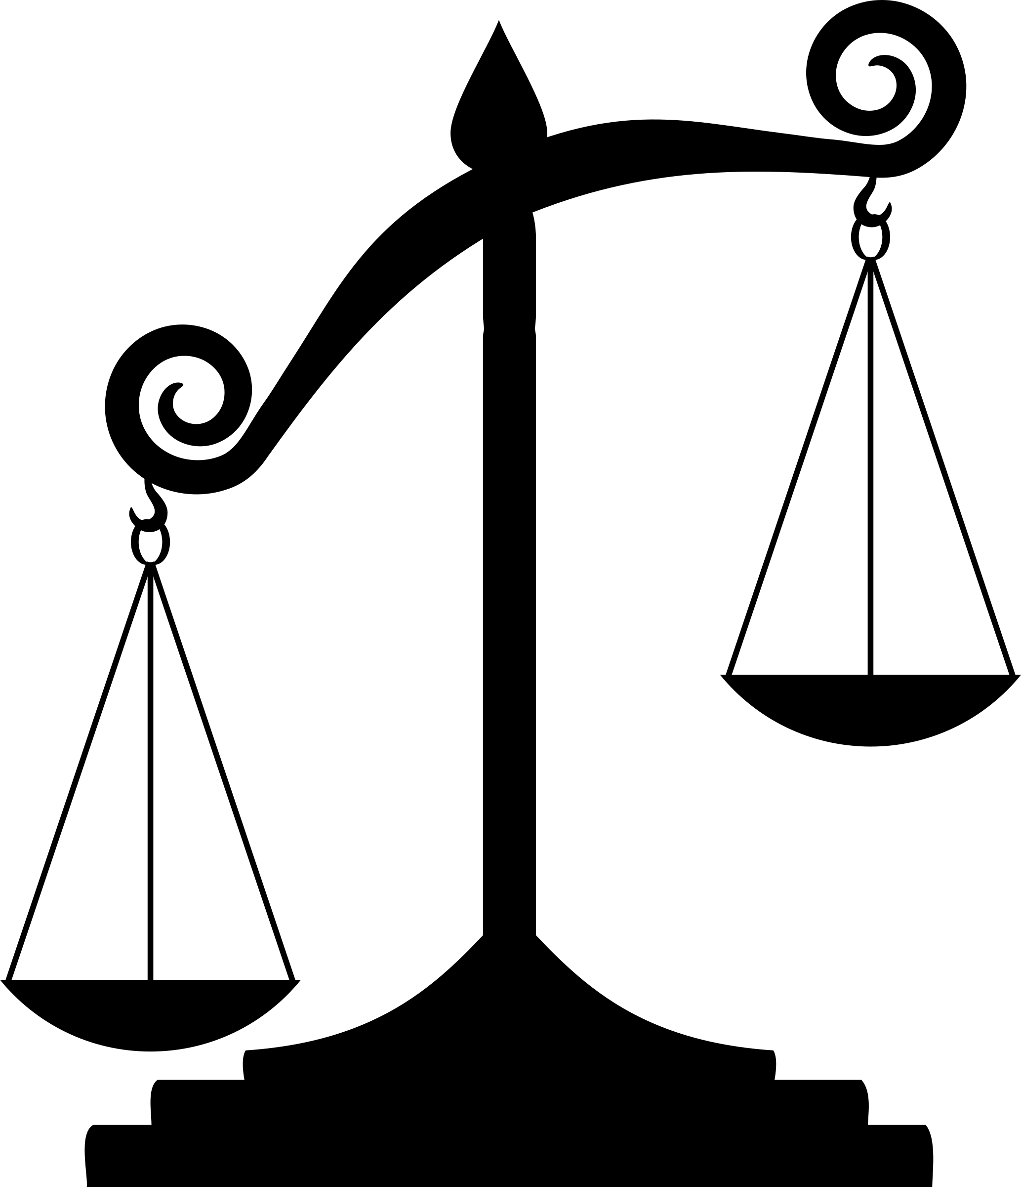
Notes:
Leadership dangers
Only 1% of the nation’s Fortune 500 CEOs are black. Only 4% are women. And only one is openly gay
Consider this: Less than 15% of American men are over six foot tall, yet almost 60% of corporate CEOs are over six foot tall.
(Exploring Unconscious Bias, by Howard Ross, Founder & Chief Learning Officer, Cook Ross, Inc.).

Slide 15
Notes:
Implicit association test
Harvard University launched a research project to demonstrate how common hidden biases are. The researchers found that at least 70% of hidden biases are directed towards African-Americans, the elderly, the disabled, and overweight individuals.
My results slightly skewed to a male leaders, even with my work as a consultant and my upbringing with a strong mom.
READ SLIDE

Slide 16
Women rank higher than men in these core leadership areas
Taking initiative
Driving for results
Seeking feedback to develop themselves
Developing others
Inspiring others
Collaboration and teamwork
Connecting the big picture to individual jobs
Notes:
On women alone:
Gender imbalance in leadership: WSJ 2012 data
Graduate entry level – 53 percent female, dropping to
C-suite – 19 percent female, 81 percent male
Zenger study rated women v men in core management functions, and in core leadership areas: women rated higher in all except for communicating powerfully and prolifically.
In purely, economic terms women, CEOs outperform male CEOs. According to Fortune magazine's research on the performance of the 1,000 largest companies, the 51 females that lead enterprises produce 37% more profit on average than the 941 Male CEOs.
Here's why: Confirmation bias. For nearly 5,000 years of recorded history are records of male leaders. So aggressive, decisive, competitive behavior is a deeply ingrained bias that equates with how outstanding leaders behave.
In a well documented experiment, Harvard MBA students evaluated the same successful case study of an entrepreneur. Half the class had a version where the person was a male, half had a version in which it was a female. The students with the male character identified his traits for success as leadership and direction, while the students with the female entrepreneur identified her as bossy and overly direct. This reflected the students’ hidden biases with how male and female leaders should act.

Slide 17
Recognizing hidden bias
Awareness is the key
Notes:
Whew, enough statistics. I hope I can turn your frustration to hope, the solution starts with awareness

Slide 18
hidden bias: common types
Skin color Gender Age
Height Weight Disability
Accents Voice Handshake
Notes:
Skin color, gender and age are generally what people think of when they consider biases, and most diversity initiatives include quotas or statistical benchmarks regarding these categories.
How about handshake bias? Research conducted by Greg Stewart of the University of Iowa demonstrated candidates with better ‘handshake scores’ were considered more hireable, correlating with the initial decisions on candidates being made in the first few minutes of the interview. Dr John Sullivan, writer for US-based ERE, stated that interviewers will often mistake bad handshakes with poor interpersonal skills, despite the fact they may simply be a symptom of nervousness or uncertainty.
2013 Duke University study showed that people with lower voices managed larger teams and made more money. Canadian study from 2009 showed that people prefer political candidates with lower voices.
Even other physical attributes: The salaries of blond women are 7% higher than those of women who are brunettes or redheads. Source: Queensland Universi

Slide 19
hidden bias: other types
Education
Introversion
Hobbies Activities
Marital and Parental Status
Notes:
My recent example being hesitant to hire single mom w two kids, and I am a working mom!
Raise hands: after seeing this list, how many can admit their own bias when hiring, or selecting vendors?
Affinity Bias. Having the tendency to prefer or like those similar to oneself. “Fit”
In-Group Bias. Perceiving those who are similar in a more positive way.
Halo Effect. Having the tendency to believe only good about someone because they are liked or letting someone’s positive qualities in one area influence the overall perception of that person. She is a good leader, so is probably a good mother
Perception Bias. Having the tendency to form assumptions or stereotypes about certain groups thus making it impossible to make objective decisions about members of those groups. Ie. Republicans versus democrats
Confirmation Bias. Having the tendency to seek information that confirms pre-existing beliefs or assumptions, or conversely to discount information that is incongruent with one’s assumptions. Leaders have consistently been portrayed as white males, so we think effective leaders need to be white males.
Cognitive: predicting the future based on current or past knowledge/trends. “they’ve always done this so probably will again”
Group Think. Having the tendency to try and fit into a particular group by either mimicking their behavior or holding back on sharing thoughts and opinions out of fear of potential exclusion. Ie. Agreeing with the majority, or Not dissenting,
Media bias--For example, when we hear about a terror threat, we have to remember we are more likely to die in traffic, drown in a bathtub, or be struck by lightning than killed in a terrorist attack.

Slide 20
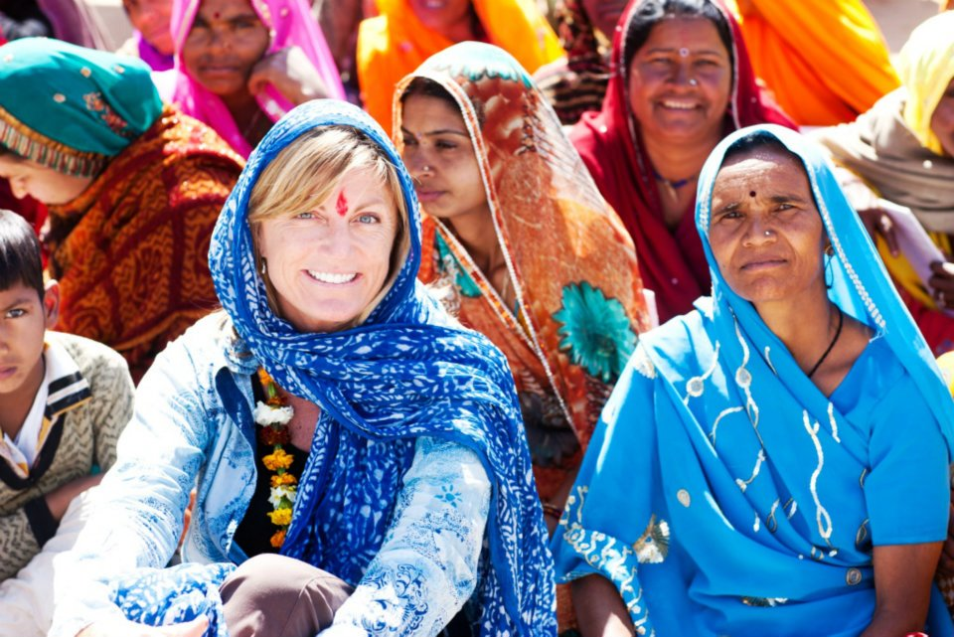
Notes:
My own bias about wealth and success; was the goal to eradicate poverty, achieve the American dream? Or empowerment, community, choice.

Slide 21
other biases affecting the workplace
Notes:
There are more than 150 types of unconscious bias that are common to the workplace. Just giving you a few
As I go over this list, think about examples where you’ve seen these

Slide 22
Biases about people or groups
Affinity
In Group
Halo Effect
Perception
Notes:
Affinity Bias. Having the tendency to prefer or like those similar to oneself. “Fit”
In-Group Bias. Perceiving those who are similar in a more positive way.
Halo Effect. Having the tendency to believe only good about someone because they are liked or letting someone’s positive qualities in one area influence the overall perception of that person. She is a good leader, so is probably a good mother
Perception Bias. Having the tendency to form assumptions or stereotypes about certain groups thus making it impossible to make objective decisions about members of those groups. Ie. Republicans versus democrats
TALK AT YOUR TABLES: can you relate to these?

Slide 23
Biases about ideas
Confirmation
Cognitive
Group Think
Media
Uncertainty
Notes:
Confirmation Bias. Having the tendency to seek information that confirms pre-existing beliefs or assumptions, or conversely to discount information that is incongruent with one’s assumptions. Leaders have consistently been portrayed as white males, so we think effective leaders need to be white males.
Cognitive: predicting the future based on current or past knowledge/trends. “they’ve always done this so probably will again”
Group Think. Having the tendency to try and fit into a particular group by either mimicking their behavior or holding back on sharing thoughts and opinions out of fear of potential exclusion. Ie. Agreeing with the majority, or Not dissenting,
Media bias--For example, when we hear about a terror threat, we have to remember we are more likely to die in traffic, drown in a bathtub, or be struck by lightning than killed in a terrorist attack.
Uncertainty bias – Thomas Albright law and justice cases. Studies have found that people can differentiate details for people in their own race better than other races. Witnesses can be overconfident because they feel pressured against uncertainty, not accurate.
TALK AT TABLES

Slide 24
Solutions for hidden bias
Breaking down walls with training and awareness
Notes:
The place to start in overcoming bias is realizing that it exists whether intentional or not, it’s neuroscience.
Once we agree that these prejudices exist, we need to build awareness of our own biases.
Next, we need to see how we can influence the cultures and groups we are in. CEO of the International Monetary Fund Christine Lagard describes how she creates an environment that welcomes divergent viewpoints: "I'm the single voice constantly in a room full of men, it's only going to carry the organisation so far. Where I think it really makes a difference is when I can endorse women in the middle management, or upper-middle management and make them – generally in the minority – make them comfortable, confident, prepared to share their views.“
Here are four solutions to conquering hidden bias

Slide 25
EXAMINE traditional diversity programs
Notes:
Reframing traditional diversity programs- pay equity and quotas are not the only issues to focus on; authentic diversity is about
Our individual identity-our values, ideas and personalities
Our individual experiences which give us judgment
Our individual capabilities-knowledge, talent and skills.
Diversity of opinion!-
IN ADDITION to traditional diversity/inclusion goals, can we incorporate these?
Evaluate selection processes
. Hiring or supplier selection
Defining “fit”
Blind resumes
Resumes with “white-sounding” names receive 50% more callbacks than those with “black-sounding” names. Source: The National Bureau of Economic Research
Establish clearly defined, measurable interview criteria against which all candidates/vendors will be evaluated.
The Level Playing Institute in San Francisco suggests companies review every aspect of the employment life cycle for hidden bias – screening resumes, interviews, onboarding, assignment process, mentoring programs, performance evaluation, identifying high performers, promotion and termination. Launch a resume study within your company and/or department to see whether resumes with roughly equivalent education and experience are weighted equally, when the names are obviously gender or race or culturally distinct.

Slide 26
build awareness to reduce the stigma
Notes:
Workforce education: FB videos
Reduce the stigma, agree that we all have it

Slide 27
Empathy is the key: your turn
"You never really understand a person until you consider things from his point of view... Until you climb into his skin and walk around in it.“
-Atticus Finch, from To Kill a Mockingbird
Notes:
Give example from Love Does book
Empathy map exercise

Slide 28
train LEADers to create psychological safety
Notes:
Leader training
Psychological safety is a shared belief that the team is safe for interpersonal risk taking. In psychologically safe teams, team members feel accepted and respected. It is also the most studied enabling condition in group dynamics and team learning research. Is it safe to be authentic?
Collaboration: meeting facilitation; allow all to lead versus authoritarian structures. Ensure all voices are heard.
Reverse mentoring
Discussing difficult topics – even topics outside the office? CEO Randall Stephenson YouTube on racial tension
How to have tough conversations, address unconscious bias and address it

Slide 29
FOSTER CURIOSITY OVER CERTAINTY
Notes:
Helps us suspend judgment. We need test our assumptions, counteract unconscious bias- the brain processes too fast
When we are defensive and unwilling to listen and consider another person’s point of view, we are not engaging in curiosity and have shut-down part of the cognitive process.
Encourage people to expand their networks, as more questions, be more CURIOUS instead of RIGHT
How we build our curiosity
Ask more and better questions
Diversify your community- personally and professionally. Challenge the notion of “fit”
Foster risk, innovation and discovery – Fail Fests. Create a culture of curiosity at home and work!
Nurture your creativity– which in turn increases curiosity – with some ideas from Daniel Pink; drive a new path, symphony, unique settings

Slide 30
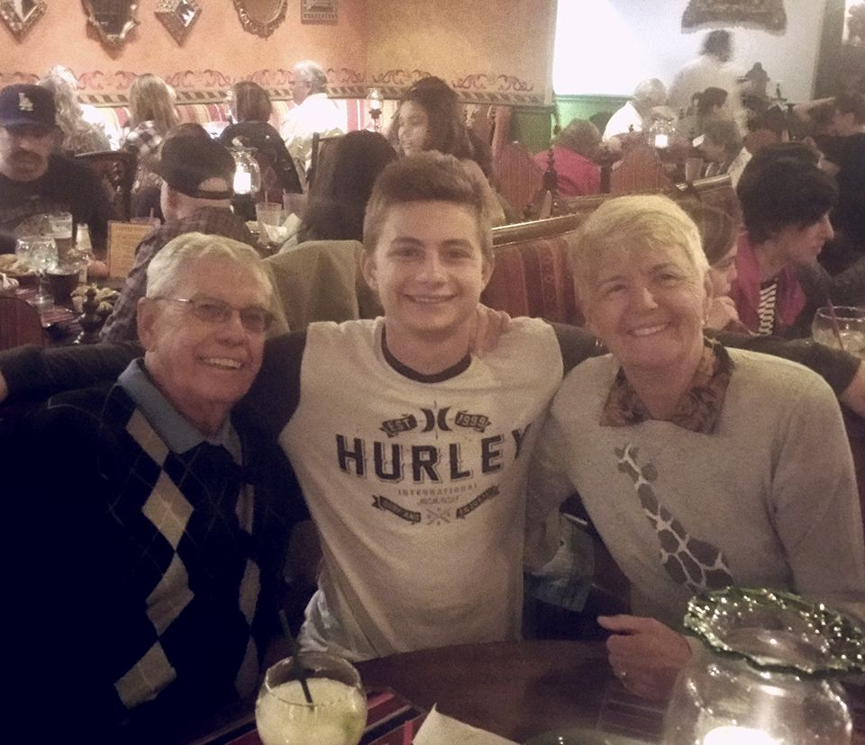
Notes:
My story about judging my mother in law
Would never have gotten to this level of our relationship and better understanding of her without asking better questions

Slide 31
Your turn
Brainstorm at your tables: How can you incorporate these solutions at the organizations where you are engaged?
Notes:
do each/alone then share- best idea per table

Slide 32
resources
Implicit Association Test
https://implicit.harvard.edu/implicit/
Facebook/Google training videos
https://managingbias.fb.com/
https://rework.withgoogle.com/subjects/unbiasing/
Empathy maps
https://www.blankcanvas.io/canvases/empathy-map

Slide 33
Thank you!
Annettegregg@gmail.com

